Slide 1



TRANSORBITAL SONOGRAPHY IN NEUROLOGY
Dr. Piergiorgio Lochner
Department of Neurology
UKS Saarland University Medical Center

Slide 2
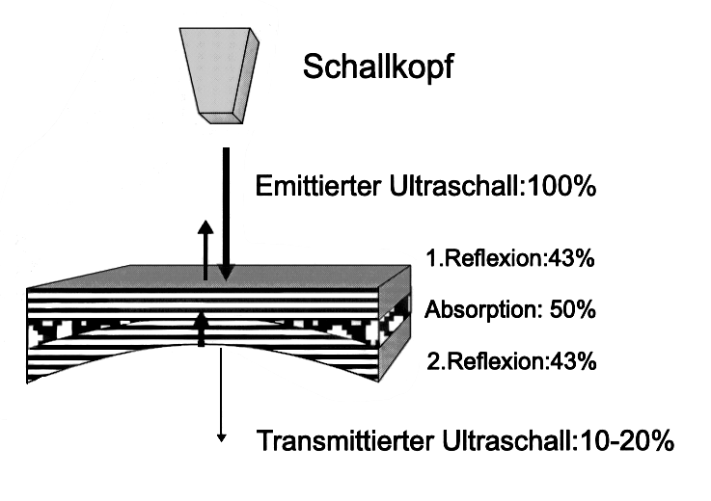
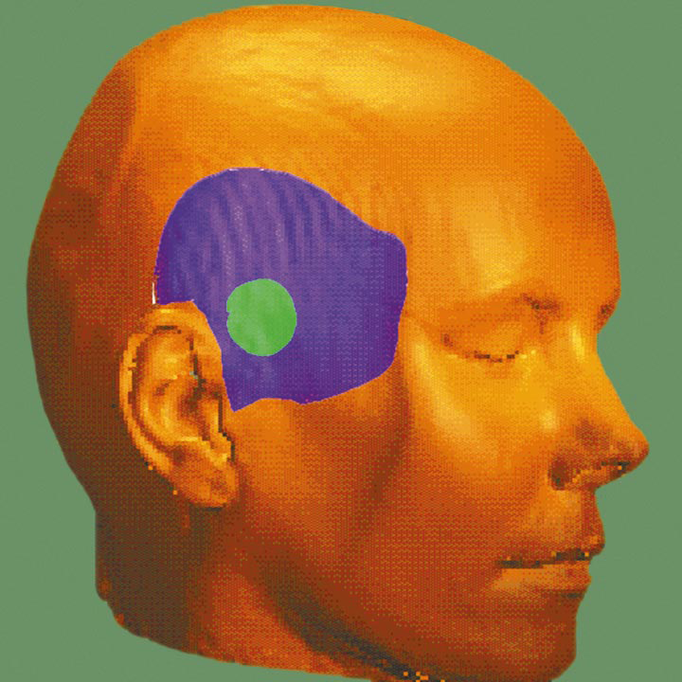
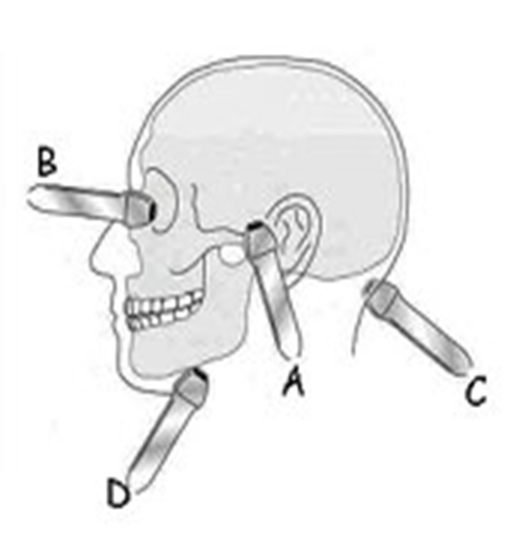



Slide 3
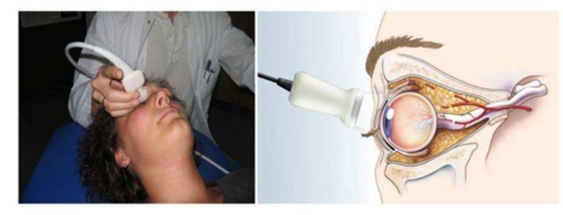
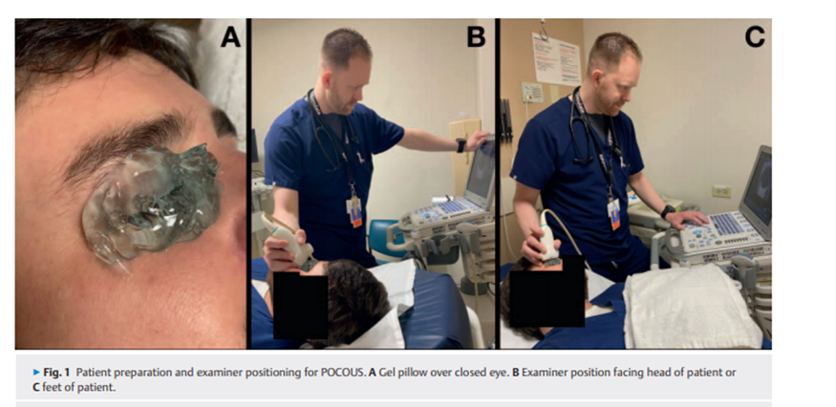
POSITION OF THE PROBE
A
B
1. Standard examination parameters. (a) Patient lies in supine position with the eyes closed. (b) The transducer is placed on the upper eye-lids (slightly lateral) with the examiner’s hand resting on the orbital margin. (c) Illustration of correct transducer positioning and anatomical overview. Copyright ® M.Ertl, with permission
Hoffmann B et al. Emergency Ocular Ultrasound Ultraschall in Med 2020
Application of Orbital Sonography in Neurology Ertl M

Slide 4
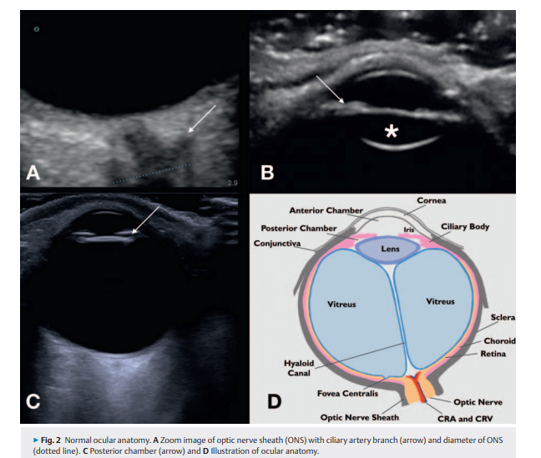

Slide 5
OCULAR PATHOLOGY

Slide 6
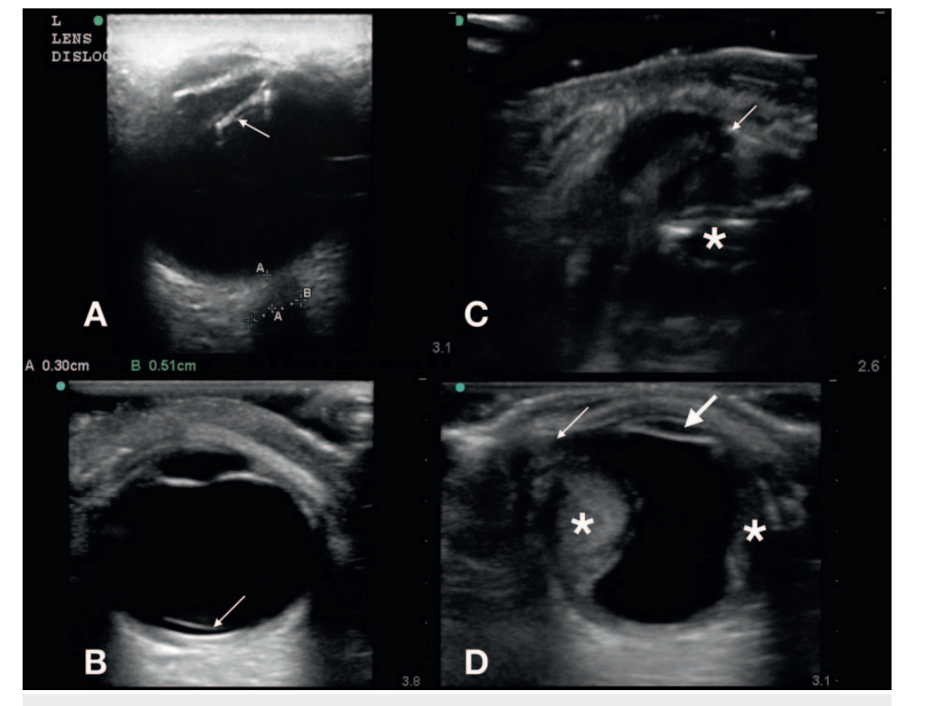
A Partial lens dislocation (arrow)
B complete lens dislocation (arrow).
C Globe rupture with distorted globe (*) and ciliary and lens structure (arrow).
D Subtle globe rupture (thin arrow) with collapsed and flat anterior chamber (thick arrow) and retinal hemorrhage (*).

Slide 7
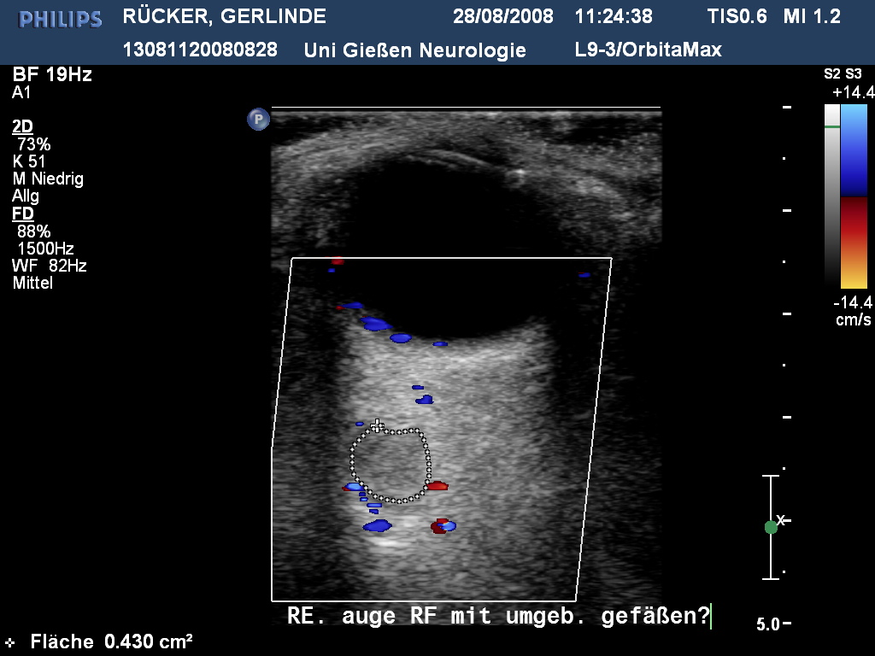
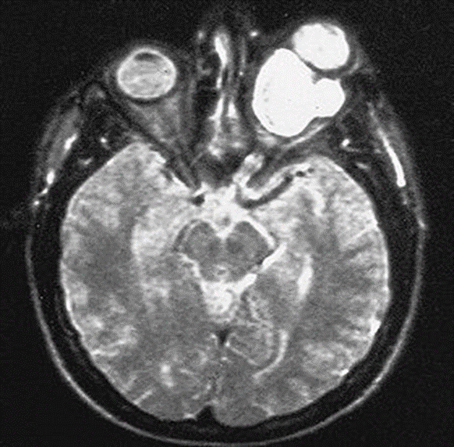
VASCULARIZED STRUCTURE

Slide 8
Terson syndrome: vitreous hemorrhage in subarachnoid hemorrhage
preretinal hemorrhage and vitreous hemorrhage
retinal haemorrhage
Dynamic
Bäuerle J et al; J of Neuroimaging 2016

Slide 9
PATHOPHYSIOLOGY

Slide 10
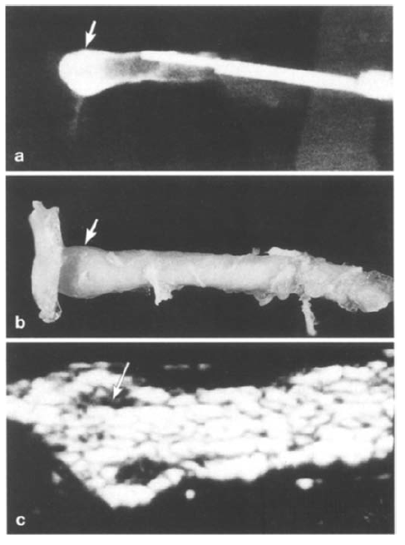
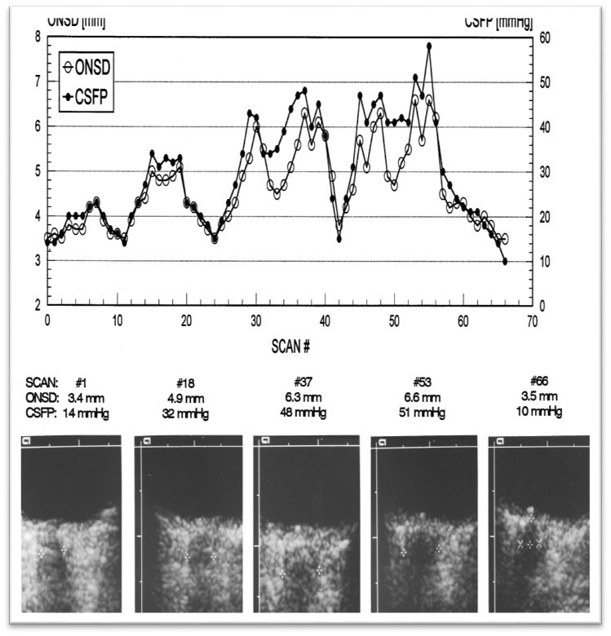
Relationship between subarachnoid optic nerve pressure and intracranial subarachnoid pressure in anatomical specimens
1) Liu D et al. Am J Ophthalmol 1993; 2) Helmke K et al. Pediatr Radiol 1996

Slide 11
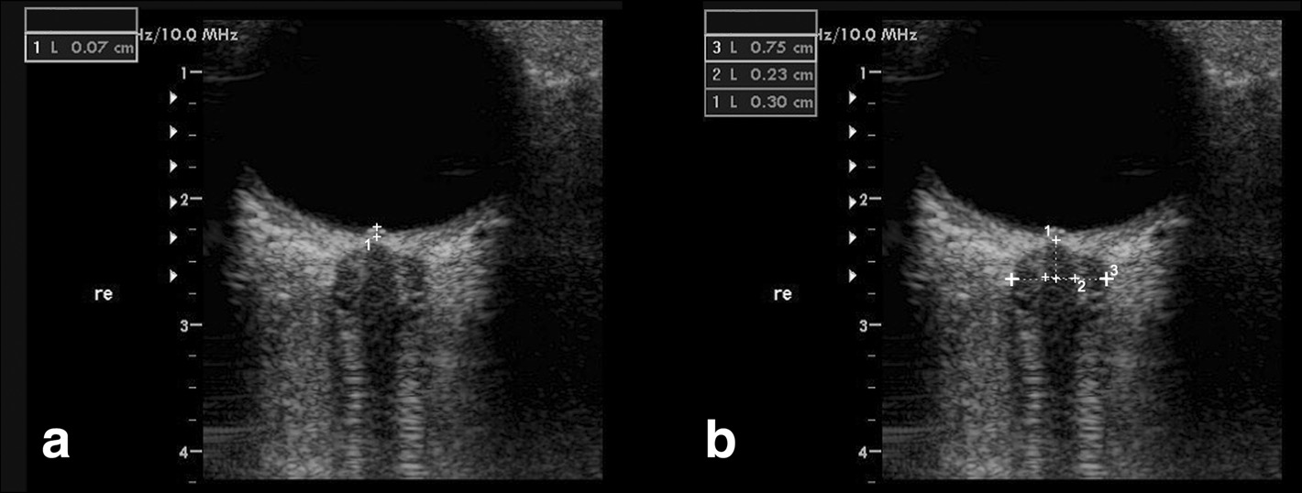
OPTIC DISC ELEVATION (ODE)
ODE
ONSD
OND
(1)ODE fundus and the dome of the papilla
OND distance inside the pia mater (2–2)
ONSD inside the dura mater (3–3).
Lochner et al BMC Neurology 2016
Notes:
Dinamicc in minuti
keine Äthiologie des Papillenödems; severe disc edema can occurr in the absence of ICP elevation
MS, sarcoidose, lymphoma, infections, neurosyphilis, malignant hypertensive retinopathy
ICP korrelieren signifikant miteinander: Der N.opticus ist von Subarachnoidalraum in Form seiner Nervenscheide umgeben und so ständig in Kontakt mit dem Liquorsystem (Bäuerle et al, 2011)
ICP korrelieren signifikant miteinander: Der N.opticus ist von Subarachnoidalraum in Form seiner Nervenscheide umgeben und so ständig in Kontakt mit dem Liquorsystem (Bäuerle et al, 2011)
→ Methode zur nichtinvasiven Hirndruckdiagnostik
Die TOS weist eine Sensitivität von 96 % für einen erhöhten ICP auf und eine Spezifität von 94% bei Werten über 20mmHg (Rajajee V, 2011)
→ Methode zur nichtinvasiven Hirndruckdiagnostik
Die TOS weist eine Sensitivität von 96 % für einen erhöhten ICP auf und eine Spezifität von 94% bei Werten über 20mmHg (Rajajee V, 2011)
ICP elevation does not cause disc swelling in acute setting
Papilledema impaired retrograde axoplasmic flow within the fibers of the optic nerve hours to day todevelop

Slide 12
MONITORING OF INCREASED INTRACRANIAL PRESSURE
Notes:
ICP-Monitoring
invasives Verfahren mit intraduraler oder intraventrikulärer oder zerebrospinaler Druck
Tympanische Membranverdrängung
Computertomographie des Schädels
Optic disc digital photograhy
Kernspintomographie
Transorbitale Sonographie

Slide 13

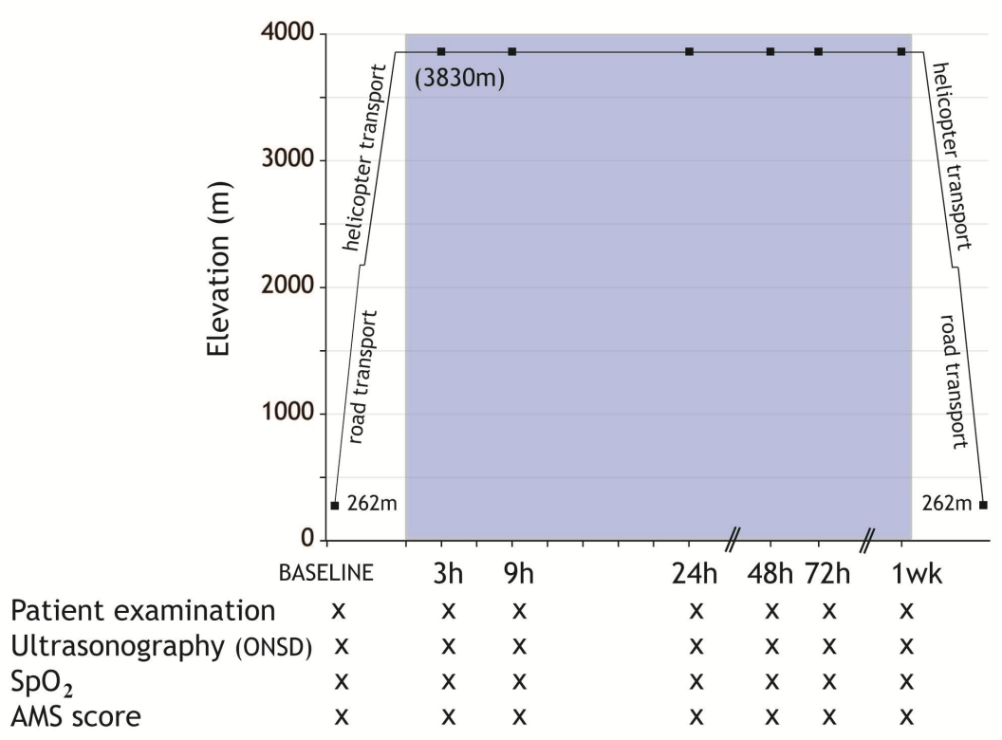
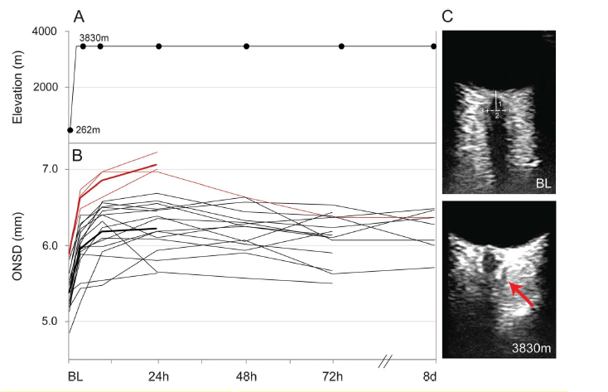
ACUTE ALTITUDE SICKNESS:
ORTLER PROJECT
Effects of hypobaric hypoxia on ONSD of a group of 19 healthy lowland dwellers using B-scan ultrasound
Lochner P et al. Neurology 2014; 2) Lochner P et al. High Alt Med Biol 2015, Review
Houze-Cerfon CH et al 2019 Prehosp Emerg Care 23:277–283
Maissan IM et al 2018 Air Med J 37:249–252.
Notes:
ONSD steigt in in einem parabolischen MusterONSD steigt mit der Höhenexposition in allen Teilnehmer in einem parabolischen Muster innerhalb des ersten
72 Stunden (p, 0.001);
Veränderungen waren innerhalb von
3 Stunden und erreichte einen Höhepunkt bei 24 Stunden. Prehospitale setting
ONSD blieb zwischen 72 Stunden vergrößert und 8 Tage (S. 5 0,93). ONSD wurde korreliert mit
SpO2 (Teilkoeffizient -0,56, p, 0,001), HR
(Teilkoeffizient 0,37, p<0,001), BR (Koeffizient 0,38, p 0,001) und LLS bei 24 Stunden Pearson-Koeffizient 0,59, p=0,008).
In brain traumatic injuries (TBI). Houzé-
Cerfon et al. was possible to measure ONSD in 19 (82%) patients
with moderate and severe TBI with 80% of ONSD measurements
validated by the experts
The success rate in the helicopter was 43% compared to 80% in the ambulance
during helicopter liftoff and acceleration in the supine position or with a raised
headrest. ONSD increased during helicopter acceleration (−
9° Trendelenburg, mean = 5.6 ± 0.3 mm) from baseline (0°

Slide 14
INTRACEREBRAL HEMORRHAGE

Slide 15
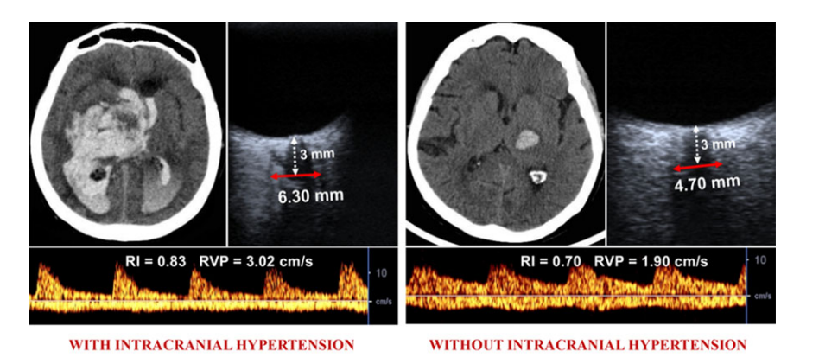
Radiological and sonographic data in patients with cerebral hemorrhage and controls
cerebral hemorrhages with increased intracranial pressure
Cerebral hemorrhages without increased intracranial pressure
Naldi A and Lochner P et al. J Neuroimaging 2019

Slide 16
MALIGNANT MIDDLE CEREBRAL ARTERY INFARCTION

Slide 17
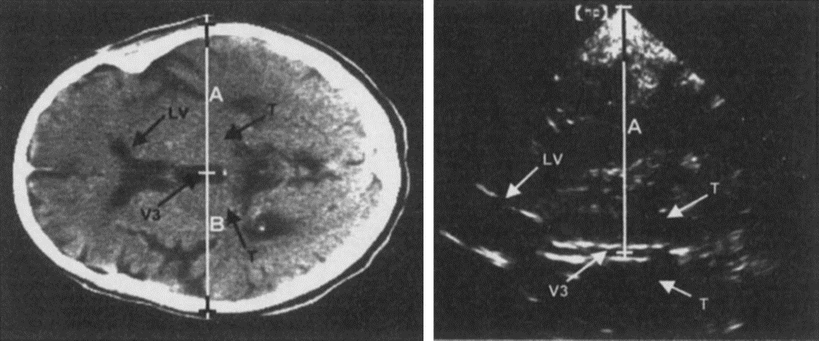
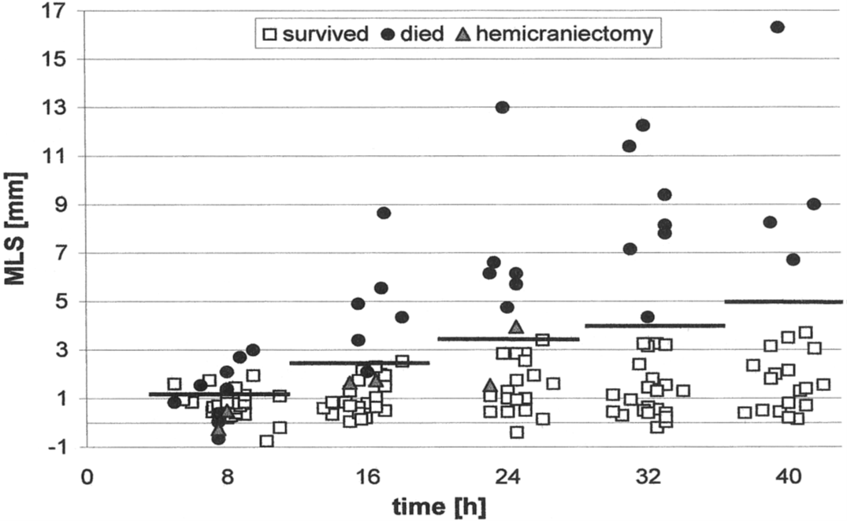
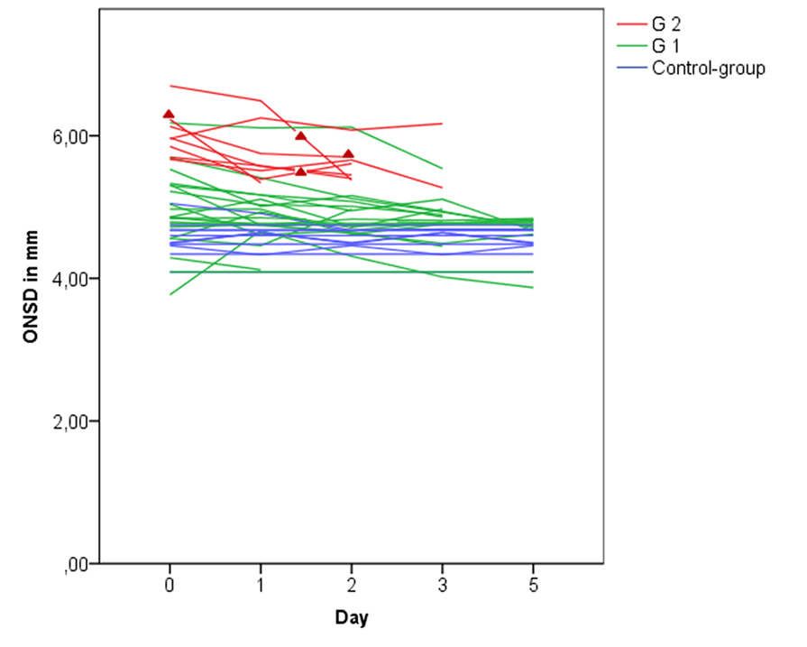
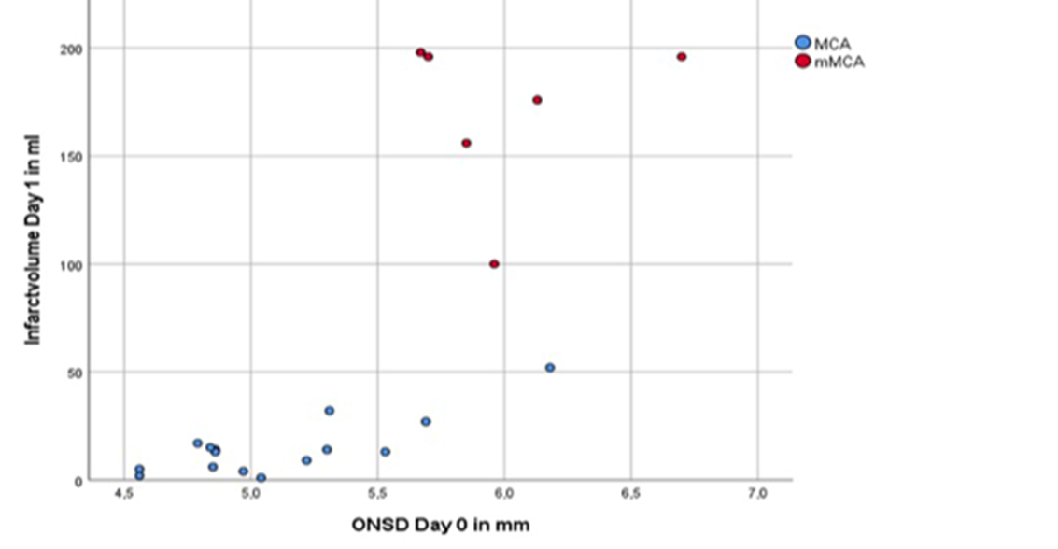
MIDLINE SHIFT AND ONSD
Seidel G. J Neuroimaging 1995, Lochner P J Neurol. 2020
Notes:
Dopo aver identificato sul piano temporale mesencefalico le arterie del circolo di Willis ed aver posto la profonditá a 16 cm.
Si ricerca 10 gradi sopra il 3 ventricolo: doppio riflesso a binario , seguito dalla calcifica ghiandola pineale
Dalla metá del terzo ventricolo in maniera perpendicolare ci si sposta sulla tabula esterna del temporale ( misura A)
Si ripete al contrario B
A-B/2
T. Gerriets Sonographic monitoring of midline shift in hemispheric infarctions Neurology 1999

Slide 18
IDIOPATHIC INTRACRANIAL HYPERTENSION
"PSEUDOTUMOR CEREBRI„
Notes:
Papilledema is optic disc swelling that is secondary to elevated intracranial pressure
Papilledema is optic disc swelling that is secondary to elevated intracranial pressure
Papilledema almost always presents as a bilateral phenomenon and may develop over hours to weeks
Optic nerve infectious, infiltrative, or inflammatory etiologies
Papilledema almost always presents as a bilateral phenomenon and may develop over hours to weeks
Optic nerve infectious, infiltrative, or inflammatory etiologies

Slide 19
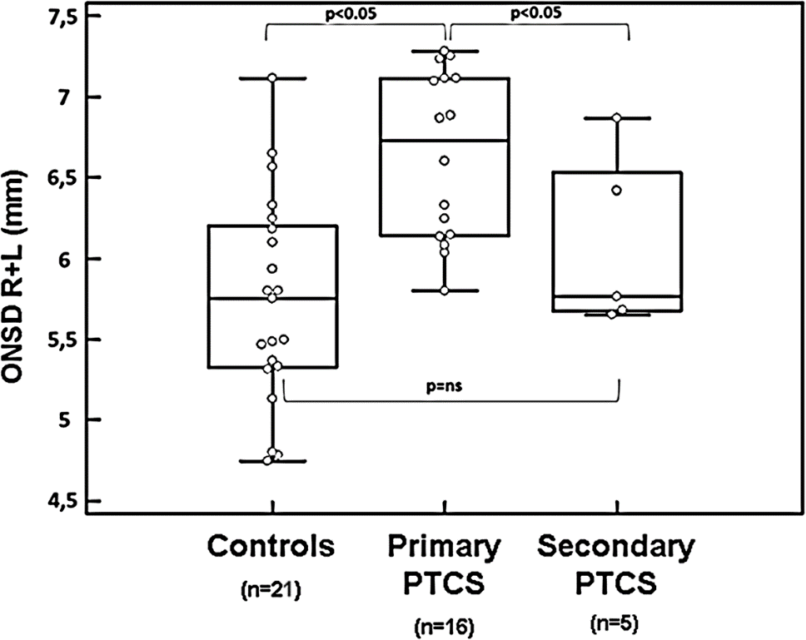
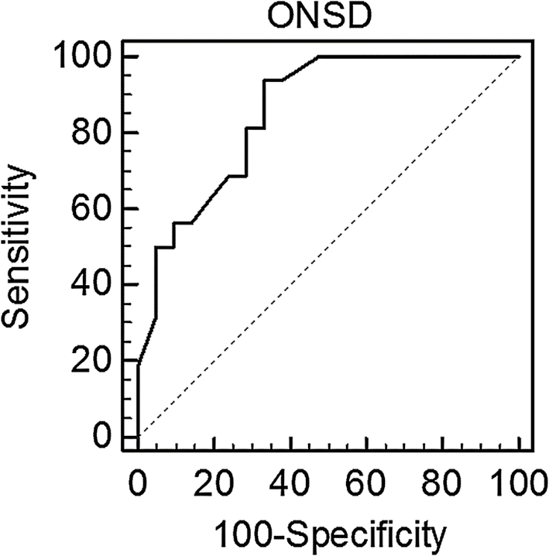
ONSD in primary and secondary intracranial hypertension
Optimal cut-off value of ONSD to predict increased intracranial pressure: 5.93 mm (AUC = 0.85; 95 % CI: 0.68-0.94; p = 0.0001). Sensitivity and specificity 93 and 67%, respectively.
Boxplot (median with interquartile area)
Lochner P et al. BMC Neurol 2016

Slide 20
Clinical and sonographic findings at admission and after 6 months
Parameter | Time0 | After 6 Months | p-value
ONSD [mm] | 6,51 (6,13–7,10) | 6,08 (5,59–6,73) | 0,002
OND [mm] | 3,02 (2,86–3,27) | 2,87 (2,70–3,15) | 0,007
ODE [mm] | 0,90 (0,64–1,36) | 0,48 (0,30–0,70) | < 0,001
Headache (VAS) | 6 (5–7) | 3 (2–5) | < 0,001
BMI [kg/m²] | 32,0 (28,8–37,5) | 28,5 (25,0–33,0) | < 0,001
Median (IQR)
ONSD = optic nerve sheath diameter; OND = optic nerve diameter; ODE = optic nerve height; BMI = Body Mass Index; VAS = Visual Analog Scale for Pain Intensity
1) Lochner P et al. J Neurol 2018; 2) Ultraschall Med 2018, Review, 3) Journal of Neurological Sciences 2021

Slide 21
MONITORING OF TRAUMATIC BRAIN INJURIES
Notes:
ICP-Monitoring
invasives Verfahren mit intraduraler oder intraventrikulärer oder zerebrospinaler Druck
Tympanische Membranverdrängung
Computertomographie des Schädels
Optic disc digital photograhy
Kernspintomographie
Transorbitale Sonographie

Slide 22
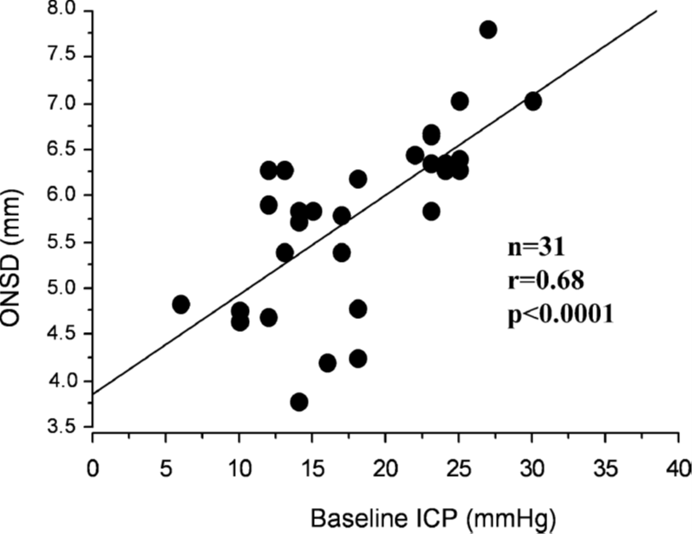
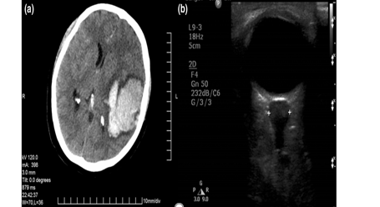
22
Soldatos T et al. Crit Care 2008, Geeraerts T Intensive Care Med 2007
Notes:
76 pazienti e 26 controlli
GCS> o < di 8 e Mrshall Scale per TAC
6.1 + o – 0.7 e 26 mm HG + o – 8.7 Comparati con controlli 4.2 e 3.6

Slide 23
HYDROCEPHALUS

Slide 24
Brzezinska R et al. Ultraschall Med 2002; Newman VD Br J Ophthalmol 2002

Slide 25
DRUSEN
Notes:
ICP-Monitoring
invasives Verfahren mit intraduraler oder intraventrikulärer oder zerebrospinaler Druck
Tympanische Membranverdrängung
Computertomographie des Schädels
Optic disc digital photograhy
Kernspintomographie
Transorbitale Sonographie

Slide 26
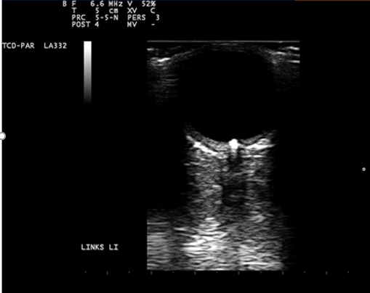
PSEUDOPAPILLENEDEMA
Notes:
fokale Ablagerung von extrazellulärem Material zwischen der basalen Lamina des retinalen Pigmentepithels
bilden Lipide, vor allem Cholesterin

Slide 27
INTRACRANIAL HYPOTENSION AND
DYNAMIC ULTRASONOGRAPHIC MEASUREMENT
Notes:
ICP-Monitoring
invasives Verfahren mit intraduraler oder intraventrikulärer oder zerebrospinaler Druck
Tympanische Membranverdrängung
Computertomographie des Schädels
Optic disc digital photograhy
Kernspintomographie
Transorbitale Sonographie

Slide 28
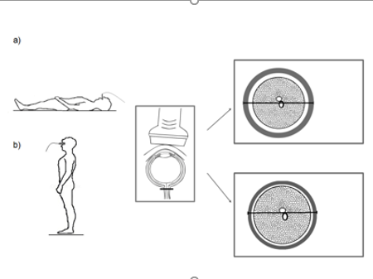
Neurological Sciences (2019) 40:2447–2457

Slide 29
TRANSORBITAL SONOGRAPHY IN ACUTE OPTIC NEURITIS: A CASE-CONTROL STUDY
RESULTS
ONSD on the affected side:
6.3 mm; IQR 5.9-7.2 mm
ONSD on the healthy side:
5.5 mm; IQR 5.1-6.2 mm; p<0.0001
ONSD controls:
5.2 mm; IQR 4.8-5.5 mm; p<0.0001
Change in ONSD depends on time of investigation.
1) Lochner P et al. AJNR 2014; 2) Lochner P et al. Clin Neurophysiol 2016, Review
Notes:
Korrelation zwischen OND und ONSD mit Visuellen Evozierten Potentialen
inverse correlation between the delay of TOS examination and ONSD diameter in the affected eye the earlier the examination, the larger the diameter
Es wurde keine Korrelation zwischen Sehnervenschellendurchmesser und Sehnervendurchmesser und Amplitude und Latenz der visuell evozierten Potenziale bei Patienten mit Sehnervenentzündung gefunden.
Assuming a median diameter of ONSD in controls of 5.0 mm, the sample needed to detect a mean difference of 1 mm, was 10 cases and 10 controls with an alpha error of 0.05 and a beta error of 0.20.
Panel A–C
(A) Optic nerve sheath diameter (ONSD) in the control eye
(B) optic neuritis: increase of ONSD (left 6.8 mm)
(C) Patients with optic neuritis with disc swelling: optic disc elevation (ODE) is gauged between the fundus ad the dome of the papilla
Inter-observer agreement between the ONSD and OND evaluations made by the two sonographers was preliminary assessed, using the same device, in 9 healthy subjects with intraclass correlation coefficients (ICC).
Inter-observer agreement was high for both ONSD (ICC 0.98, 95% CI 0.93-1.00) and OND (ICC 0.98; 95% CI 0.92-1.00)
Korrelation zwischen OND und ONSD mit Visuellen Evozierten Potentialen

Slide 30
NEUROLOGICAL COMPLICATIONS IN NOT NEUROLOGICAL SETTINGS

Slide 31
PREGNANCY
Pregnancy is associated with pathophysiological changes which predispose to several neurologic disorders.
ONSD can predict the development of preeclampsia and eclampsia:ONSD was significantly higher in preeclamptic patients compared to healthy pregnant women at delivery with 20 to 43%of preeclamptic patients having ONSD values compatible with intracranial pressure above 20 mmHg.
Block HS, Biller J (2014) Neurology of pregnancy. Handb ClinNeurol 121:1595–1622.

Slide 32
CARDIAC ARREST/COMA
ONSD measurement is valuable as a prognostic indicator of hypoxic encephalopathy, both on CT or ultrasound with contrast
ONSD at admission associated with a favorable prognosis was 5.0 mm (4.4–6.1 mm).ONSD of 6.1 mm (5.4–7.2 mm)was associated with poor prognosis. ONSD of ≤ 5.4 mm was associated with a favorable prognosis with a sensitivity of 83%(95% CI 36–100) and specificity of 73% (95% CI 39–94)
Better prognostic value was observed when ONSD was combined with other parameters
such as gray-to-white matter ratio on initial CT scan in post-cardiac arrest subjects.
Chelly J et al (2016) Resuscitation 103:7–13
Ueda T, et al.(2015) J Neuroimaging :927–930
ChaeMK et al Resuscitation (2016) 104:40–45

Slide 33
INTRAOPERATIVE COMPLICATIONS
The laparoscopic surgery requires adequate surgical exposure and the application of a CO2 pneumoperitoneum (PP) and often a concomitant steep head–down position (up to 45°,Trendelenburg position), together increasing the risk for decreased venous return, variation of mean arterial pressure and systemic vascular resistance, hypercapnia, and therefore an increase of ICP.
Significant increase of ONSD during PP and TP. A meta-analysis of 460 subjects showed that ONSD increase significantly in both the early period (0–30 min) and late period(30–120 min) during CO2 pneumoperitoneum
Bernal W, Wendon J (1999) Eur J Gastroenterol Hepatol. Dubost C, Anesthesiology 2012, Chelly J Resuscitation (2016)

Slide 34
VASCULAR DIAGNOSTICS:
CENTRAL RETINA ARTERY AND VEIN

Slide 35
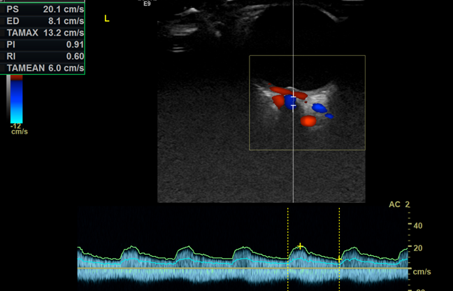
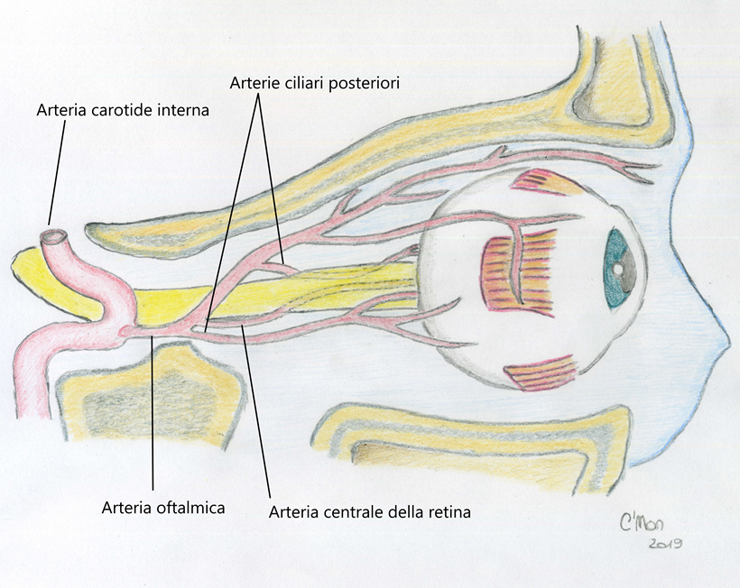
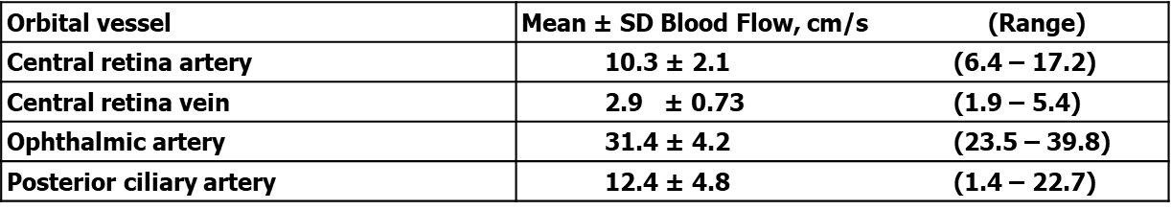
CENTRAL RETINA ARTERY AND VEIN
Baxter et al. J Ultrasound Med 1995;14:91-6.
Notes:
ophthalmic artery (OA): first intracranial branch of the internal carotid artery. optic foramen in the posterior
Resistive index (RI) maximum and minimum velocity (v-max, v-min), retinal venous pulsation (RVP)
and the central retinal artery (CRA) he OA usually crosses the optic nerve into the anteromedial orbit.
At this location, the OA can be identified using color Doppler imaging by examining medial to the optic nerve and about 1.5 mm posterior to the globe. A wide variety of anatomic variation can be seen with the OA. The arterial waveform of the OA reflects a typically peripherally located high-resistance artery. T
he systolic and diastolic flows are normal if the OA is 31.4 ± 4.2. The prominent initial peak is followed by a typical incisura, and much less diastolic flow (▶ Fig. 3).
The CRA is the second important artery. The CRA exhibits a characteristic low resistance waveform with continuous diastolic flow, typically 10.3 ± 2.1 cm/s.
The CRA and central retinal vein (CRV) run parallel to each other in the center of the distal optic nerve and supply the inner two-thirds of the retina. The CRV is found next to the CRA with continuous venous flow in the opposite direc

Slide 36
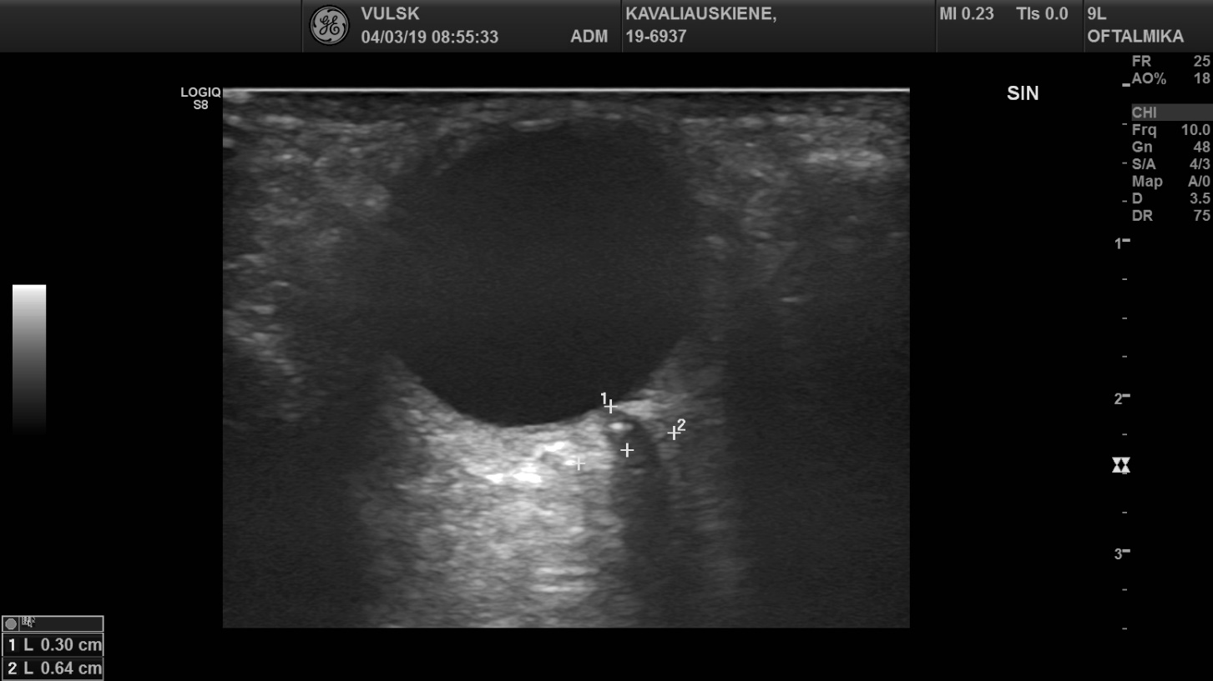
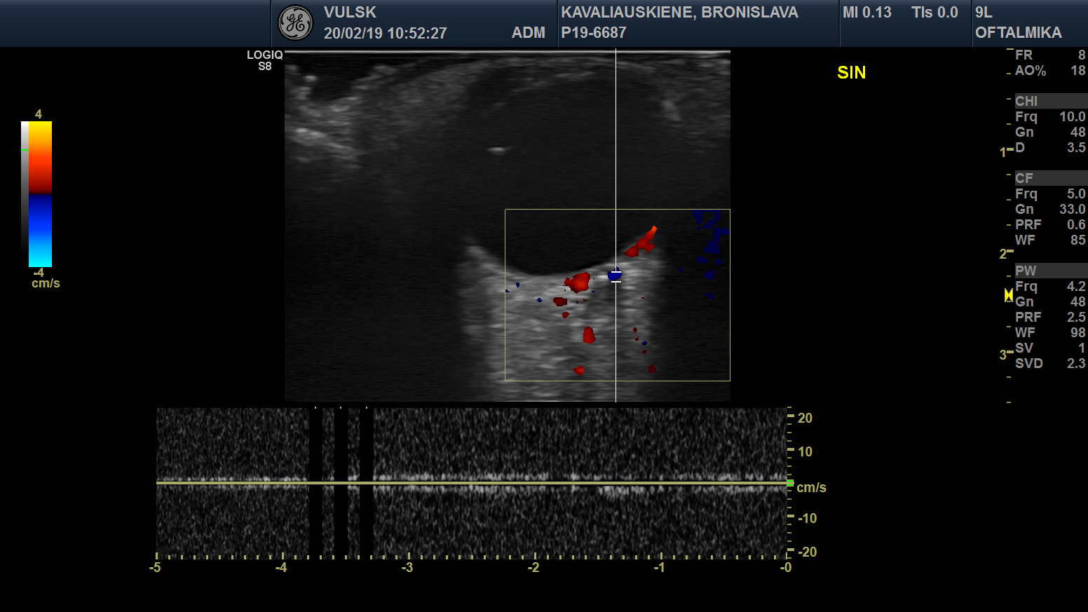
B.
A.
B-mode: retrobulbar “spot sign”
Color-mode: no flow in the left CRA

Slide 37
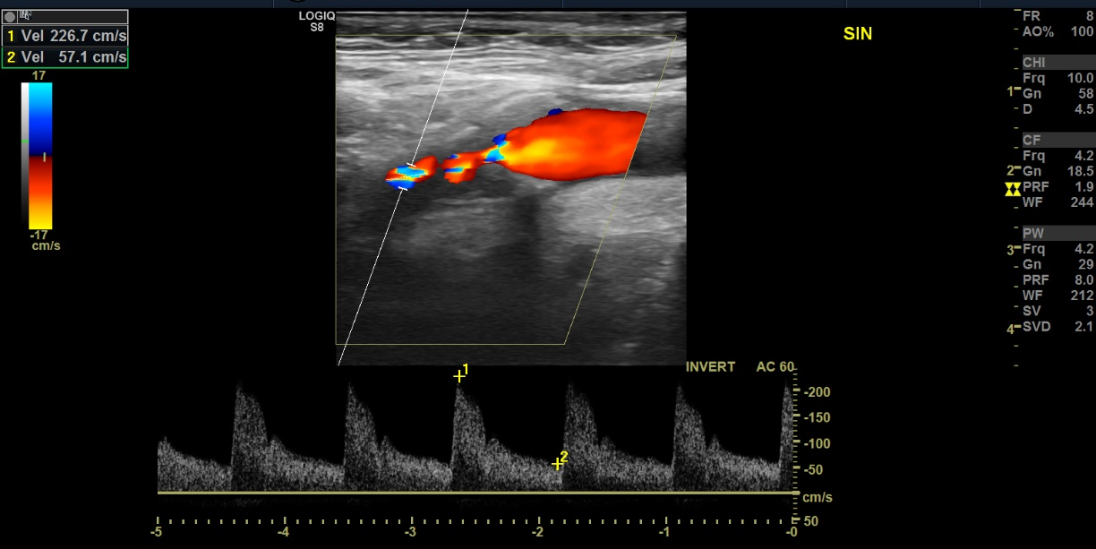
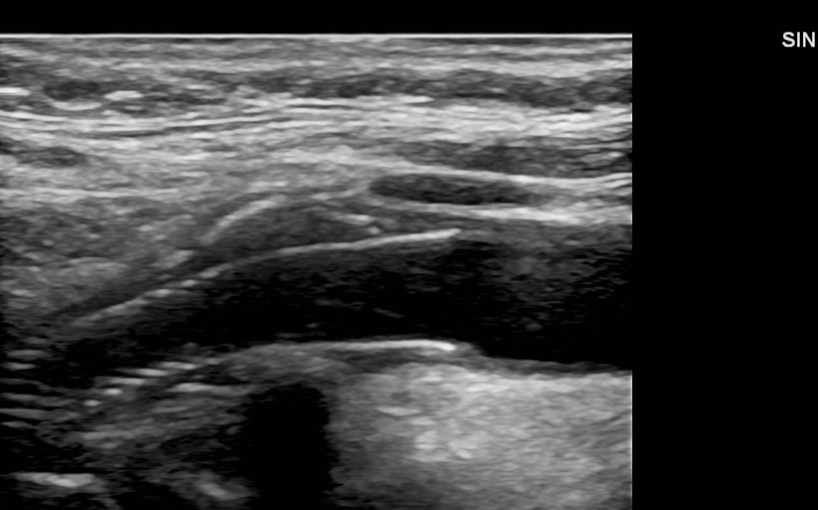
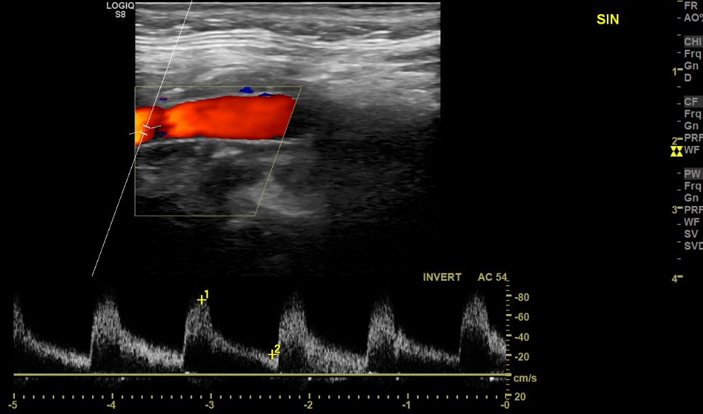
Ocular-POCUS
Left ICA > 70% stenosis
Left ICA after stenting
Notes:
Advertising Ten-CRAOS, only if Piergiorgio wants to insert in his talk, but perhaps we can leave it to the questions in the discussion, that we can make to each other. Have you already included a patient? We don’t have yet everything settled here for the study, we have asked Anne for some support, and we are expecting that.

Slide 38
EXAMINATION OF THE PUPIL

Slide 39
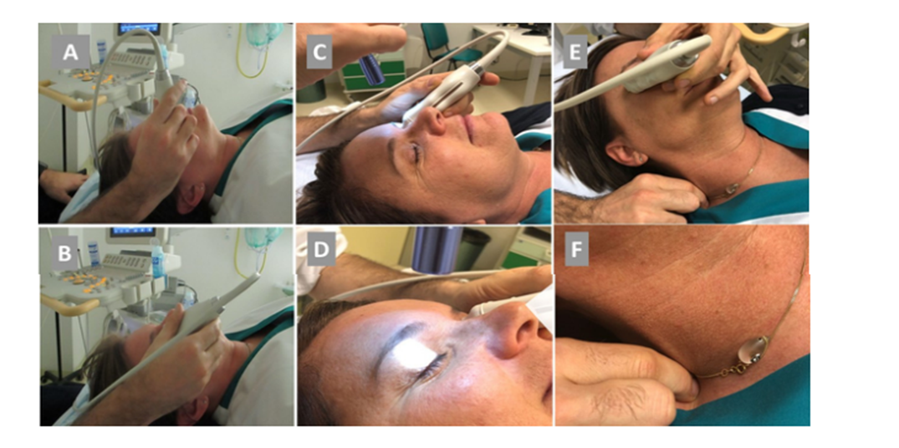
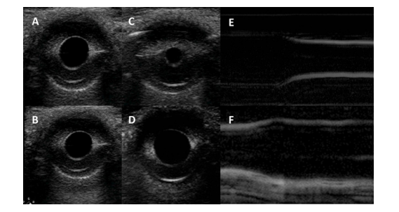
Ultrasound pupillary assessment
probe starting position; (B) proper angle of the probe for pupil insonation; (C) direct PLR testing; (D) consensual PLR testing; (E) CR testing; (F) example of neck pinching
Ultrasound pupillary assessment. (A) PD at rest in B-mode imaging; (B) example of measurement of PD; (C) PD after ipsilateral PLR; (D) PD after CR; (E) continuous m-Mode recording of PLR; (F) continuous m-Mode recording of PLR
Farina S et al Ultrasound Examination of the Pupil - A New Tool for the Neuro-Ophthalmological Assessment. Ultraschall Med. 2021 Feb;42(1):84-91.

Slide 40
PERSPECTIVES

Slide 41
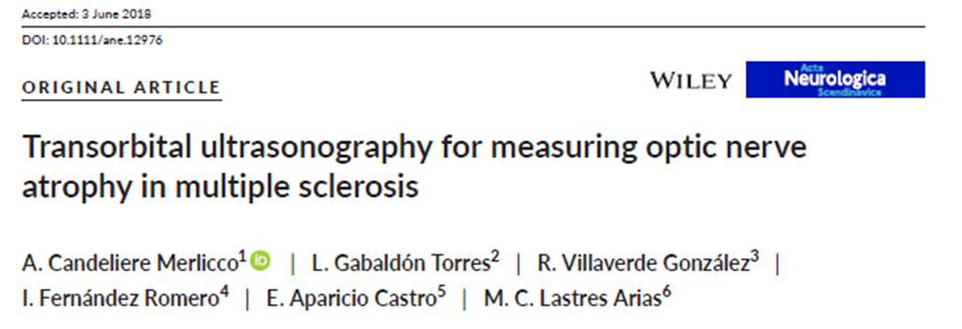
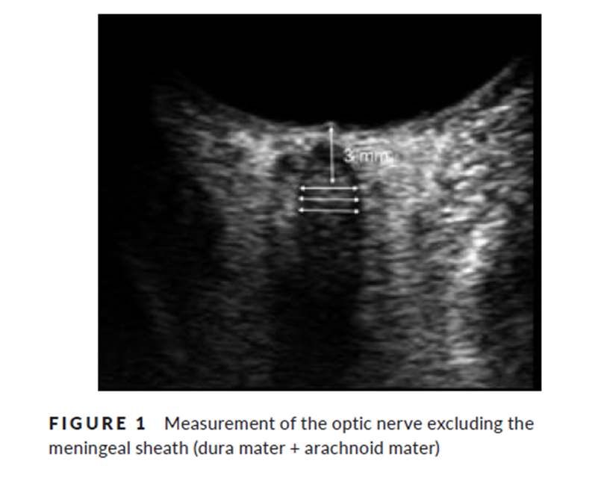
PERSPECTIVES
Automatic Optic Nerve Measurement: A New Tool to Standardize Optic Nerve Assessment in Ultrasound B-Mode Images Ultrasound in Medicine & Biology
Volume 46, Issue 6, 2020
Koraysha NA, et alNeuropsychiatr Dis Treat. 2019
Candeliere et al. Acta Neurol Scand. 2018

Slide 42

piergiorgio.lochner@gmail.com
Optic nerve sheath diameter: present and future perspectives for neurologists and critical care physicians. Neurol Sci (2019).

